Slide 1
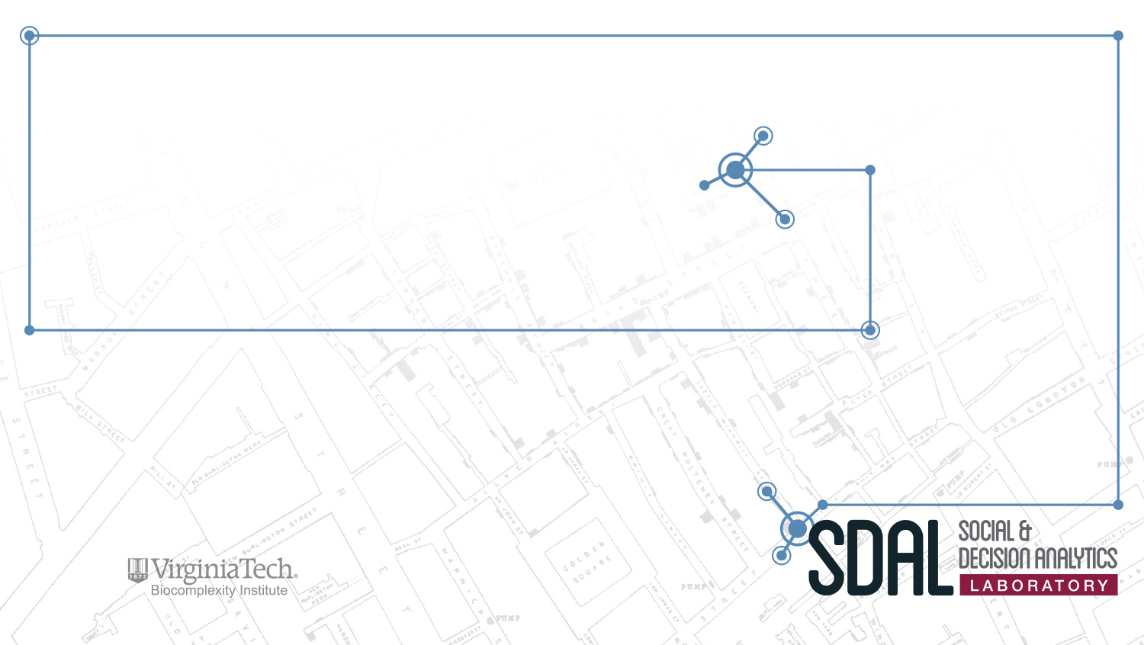
Group Project: Community Profiles and Composite Indicators
SDAL Leads: Vicki Lancaster, Aaron Schroeder, Dave Higdon
SDAL Team: Everyone
Sponsor: Cooperative Extension

Slide 2
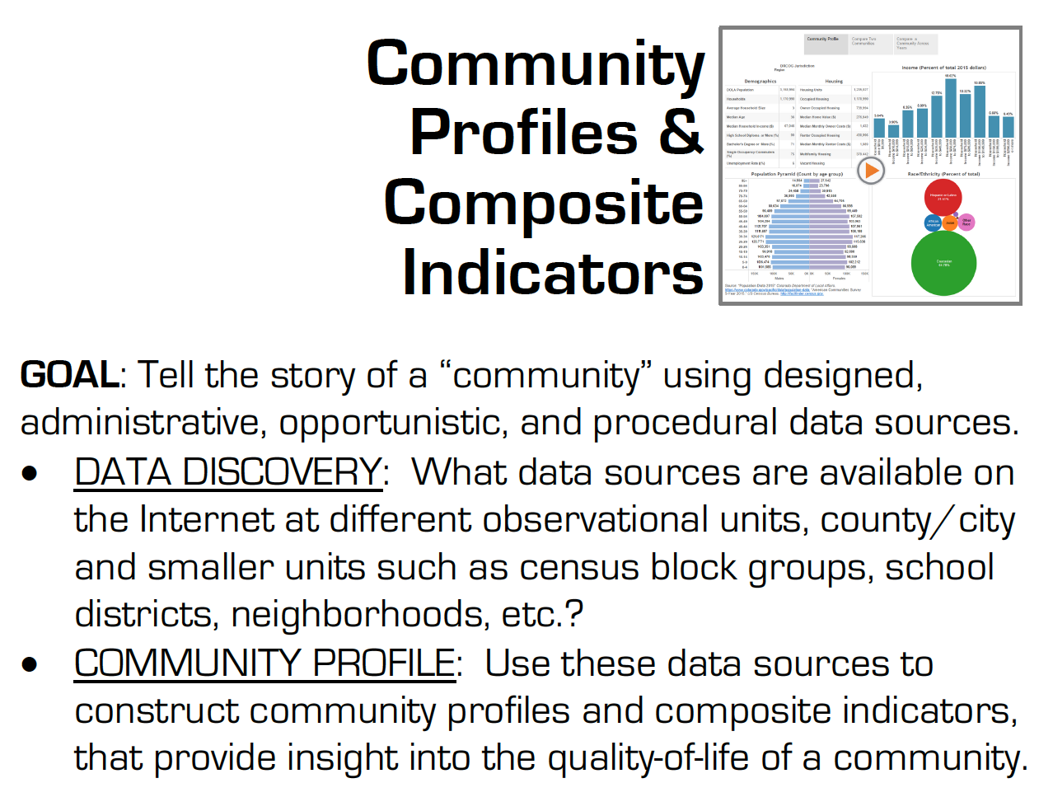

Slide 3
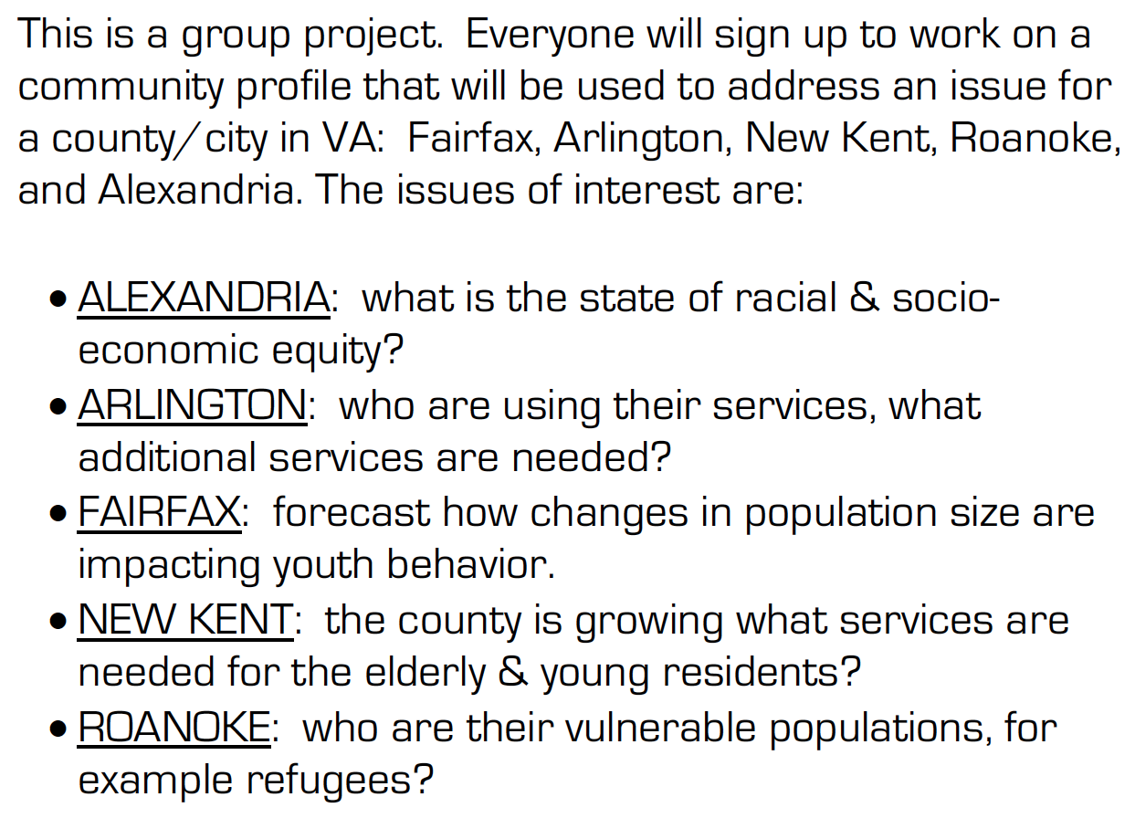

Slide 4
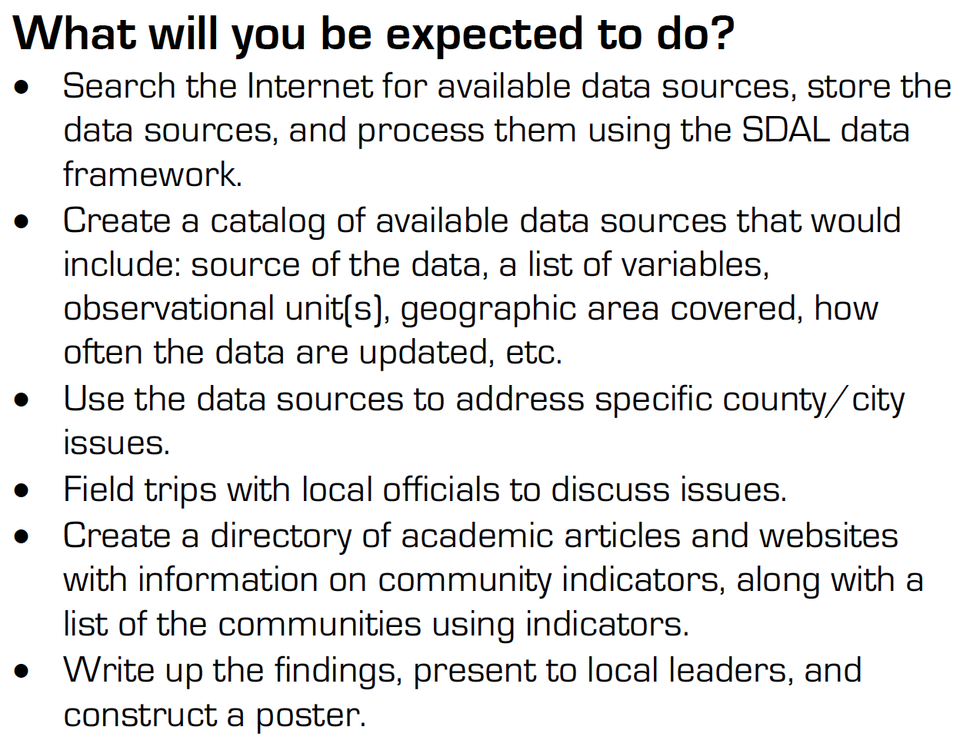

Slide 5
Measuring the Impact of Open Source Software Innovation
SDAL Leads: Stephanie Shipp & Gizem Korkmaz
SDAL Team: Josh Goldstein
Sponsor: National Science Foundation (NSF) –
National Center for Science and Engineering Statistics (NCSES)

Slide 6
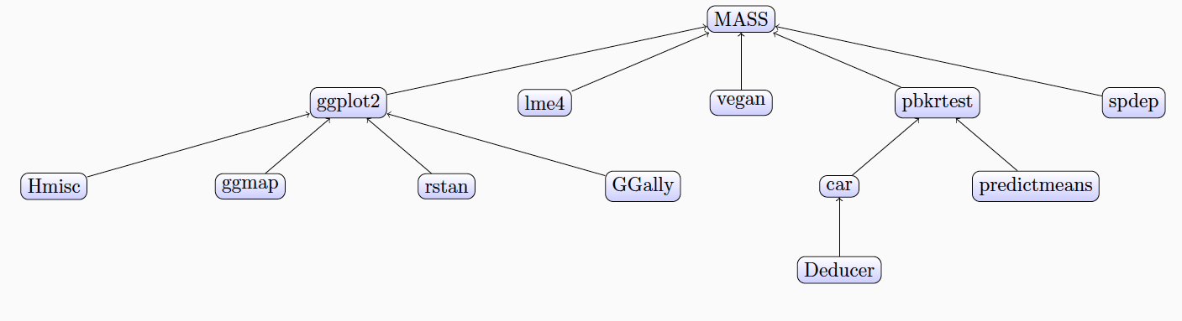
Project Overview
Current NCSES and other economic indicators do not measure the value of goods and services that do not have market transactions,
The goal is to test the feasibility and to develop methods to measure the impact and scope of open source software
Notes:
i.e., they are not captured in surveys nor are in economics measures such as the Gross Domestic Product (GDP).

Slide 7
Research Questions
What sources of data and variables could serve as proxies for measuring attributes and economic value of open source software?
Counts of OSS, by sector, by technology, by cost, by benefits, by geography
Attributes, e.g., # citations, #downloaded, # sectors, etc.
How accessible are these data sources and variables from a repeatability and reliability perspective?
What indicators or models could be created to measure attributes and eventually economic value?
What are gaps or limitations in the proposed approaches?

Slide 8
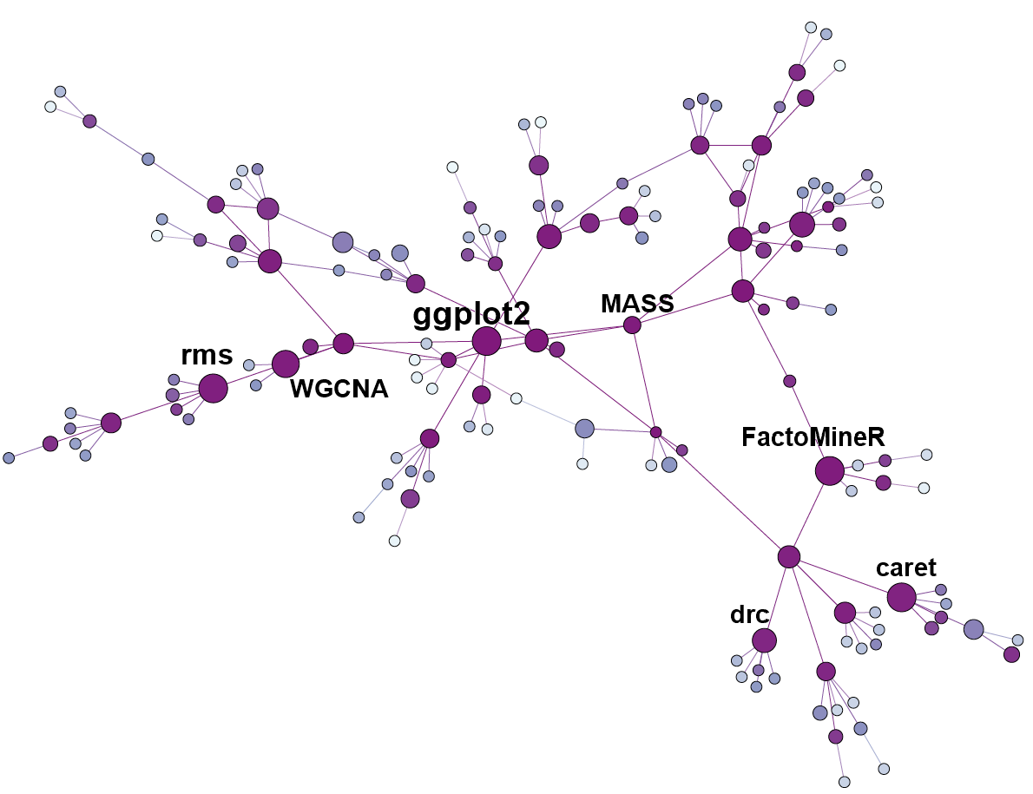
Project Plan/Requirements
Building on research conducted during Summer 2016, Fall 2016, and Spring 2017
Understanding existing cost/value models for private software
Adapting to open source software
Data collection (webscraping)
Modeling and network analysis

Slide 9
Measuring Business Innovation Using Non-Traditional Data Sources
SDAL Lead: Gizem Korkmaz
SDAL Team: Stephanie Shipp, Bianica Pires
Sponsor: National Science Foundation (NSF) –
National Center for Science and Engineering Statistics (NCSES)

Slide 10
Project Overview
Current practice to measure business innovation is to survey a sample of companies.
This project aims to test the feasibility of developing innovation metrics using non-traditional data sources including product announcements, press releases, and other information obtained through web scraping or queries of selected companies.
Notes:
i.e., they are not captured in surveys nor are in economics measures such as the Gross Domestic Product (GDP).

Slide 11
Research Questions
How do companies measure innovative activities, investments, outputs, and outcomes?
How can opportunity and administrative data be leveraged? What information could be obtained using non-traditional data sources? What methods and models are needed to adapt
What type(s) of innovation (i.e., product, process, marketing, and organizational) could be captured using opportunity and administrative data sources?
Can follow-up interviews with a sample of identified companies be used to confirm and/or contradict the methods and measures?

Slide 12
Project Plan/Requirements
Review of academic and gray literature: How do companies measure innovation?
Data discovery to identify potential data sources to develop measures of innovation
Data screening and inventory for the selected businesses for discovered data sources; acquire selected data sources through scraping websites, accessing administrative data, etc.
Data quality process – profiling, cleaning, and exploratory analysis of data sources that emerge from the screening and inventory process
Statistical analyses and mappings between types and sources of innovation and data sources

Slide 13
Identifying All (Traditional and Non-traditional) STEM Pathways
SDAL Lead: Bianica Pires
SDAL Team: Stephanie Shipp, Aaron Schroeder, Gizem Korkmaz
Sponsor: National Science Foundation (NSF) –
National Center for Science and Engineering Statistics (NCSES)

Slide 14
Identifying All (Traditional and Non-traditional) STEM Pathways
NSF National Center for Science and Engineering Statistics (NCSES) is responsible for the collection, interpretation, analysis, and dissemination of objective data on the science and engineering enterprise. They are responsible for statistical data on:
Research and Development, and Innovation
The science and engineering workforce
U.S. competitiveness in science, engineering, technology, and R&D
The condition and progress of STEM education in the United States
NCSES overseas many surveys, such as the Survey of Earned Doctorates, National Survey of College Graduates, Survey of Graduate Students and Postdoctorates in Science and Engineering

Slide 15
Project Overview
Current NCSES reporting does not fully capture the full set of diverse pathways, steps, and outcomes an individual can take to be trained for and enter the STEM workforce
The goal for this project is to identify pathways and data sources to fill in these gaps

Slide 16
Research Questions
What are the education and workforce pathways that lead to a STEM-enabled occupation?, e.g. degrees (AA/BS-BA/MS-MA/PhD/other), online training, certificates, worker training, vocational / apprenticeship training etc.
Other questions of interest
What are STEM pathways for sub-baccalaureate populations? e.g. high school and community college graduates, vocational / apprenticeship training, other.
What are STEM pathways for women and minorities? Where along the pathway do they leave?
Notes:
How do STEM professionals represent themselves? (e.g., when an individual calls himself or herself a Data Scientist, what STEM education, training, and skill sets does that represent?)
How do employers represent their skill set needs?
Is it possible to quantify a job improvement through promotion?
Do non-survey data sources exist to measure STEM pathways, e.g., scraping websites, administrative data, other.
Are there untapped surveys that exist to measure STEM pathways?, e.g. IPEDs?

Slide 17
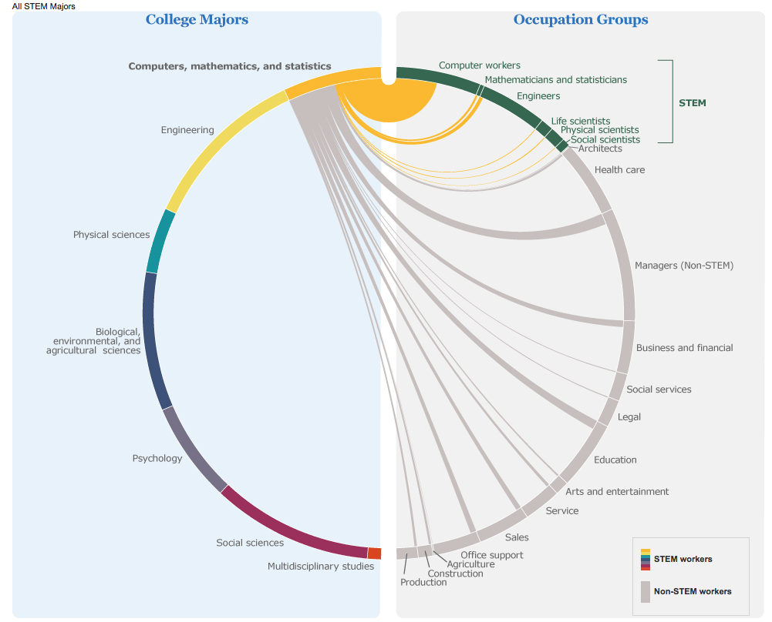
Example Pathways to STEM Workforce
https://www.census.gov/dataviz/visualizations/stem/stem-html/

Slide 18
Project Expectations
Conduct literature review on pathways to STEM occupations and how STEM needs are characterized both by the workers and employers
Develop pathways diagram(s) from Education to STEM workforce for 2-3 examples
Conduct data discovery process related to the pathways
Conduct data screening and inventory for discovered data
Use data in analysis to demonstrate STEM pathways for the 2-3 examples

Slide 19
Fee Evasion in Public Transportation
SDAL Lead: Vicki Lancaster
SDAL Team: Gizem Korkmaz, Aaron Schroeder,
Dave Higdon, Joshua Goldstein
Sponsor: Washington Metropolitan Area Transit Authority (WMATA)

Slide 20
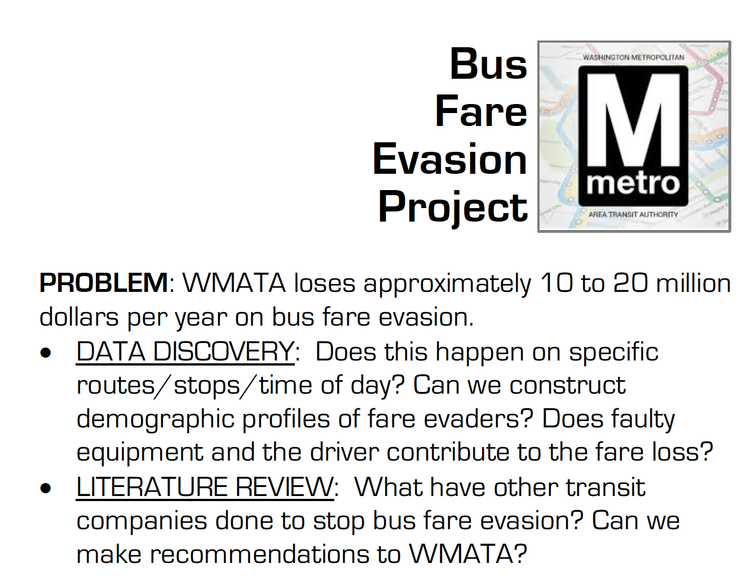

Slide 21
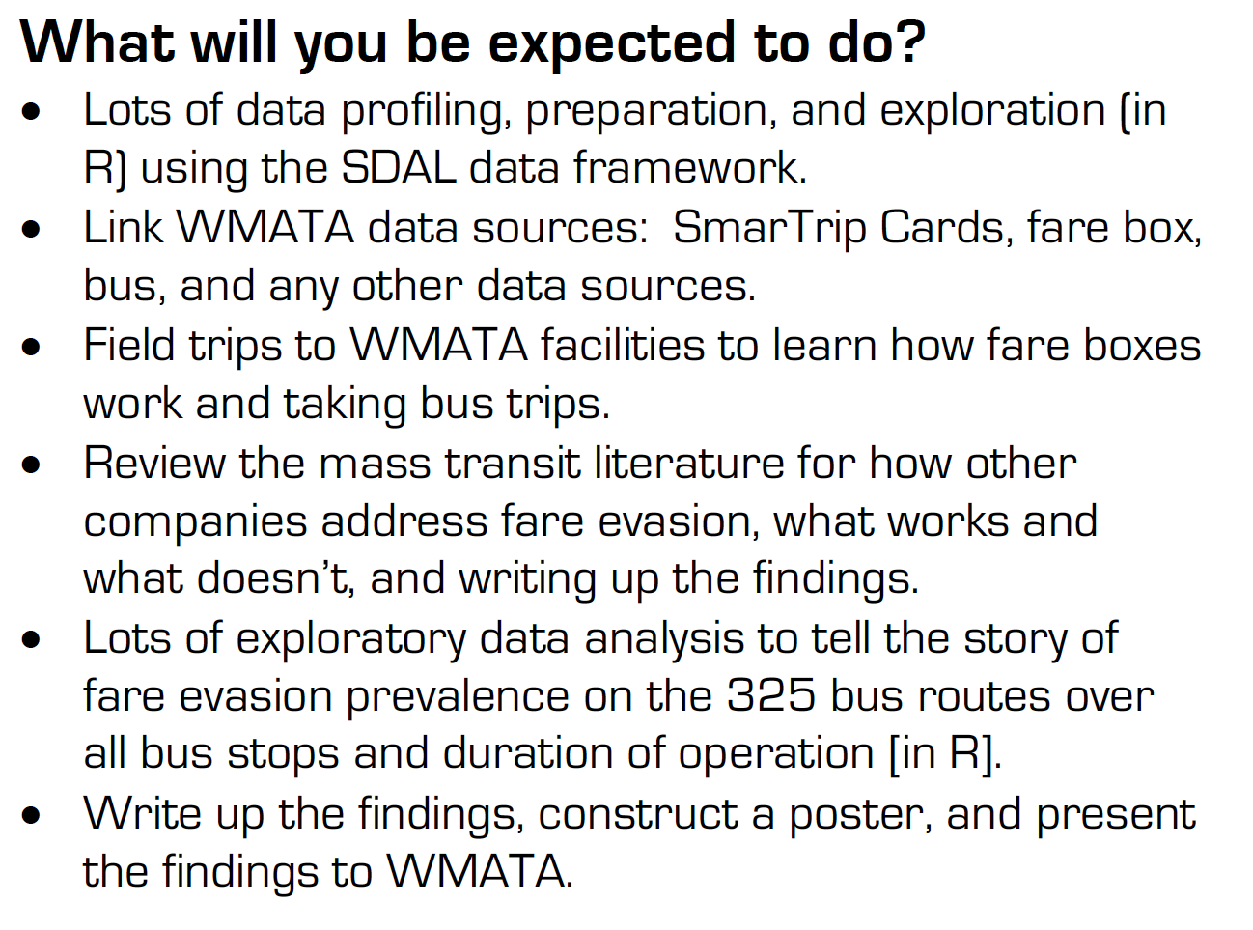

Slide 22
Repurposing 911 Data toward Evidence-Based Policy
SDAL Lead: Gizem Korkmaz
SDAL Team: Josh Goldstein, Aaron Schroeder, Dave Higdon, Madison Arnsbarger
Sponsor: Arlington County Police and Fire Departments

Slide 23
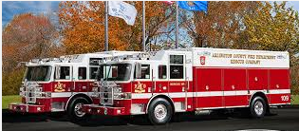
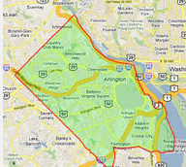

Project Overview
Situational Awareness: to improve quality of life and services while accelerating the county’s efficiency and resiliency

Slide 24
Research Questions
What is the impact of the actions / programs / campaigns established by law enforcement?
What to expect from specific events so that they can be better prepared?
Criminal networks and repeated offenders in Arlington
Which factors affect emergency response time?
Predicting houses in need of police

Slide 25


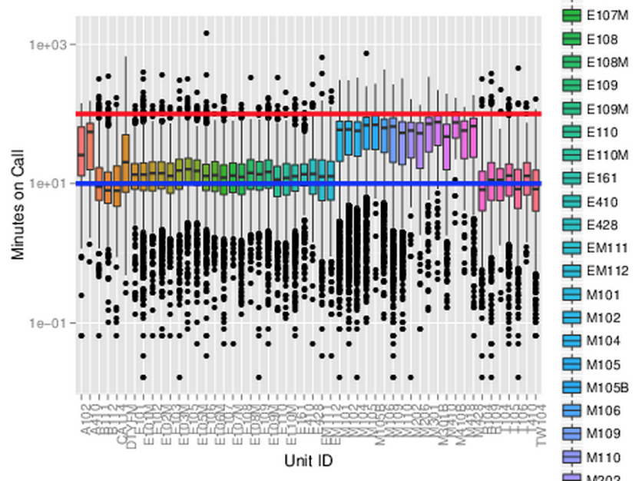
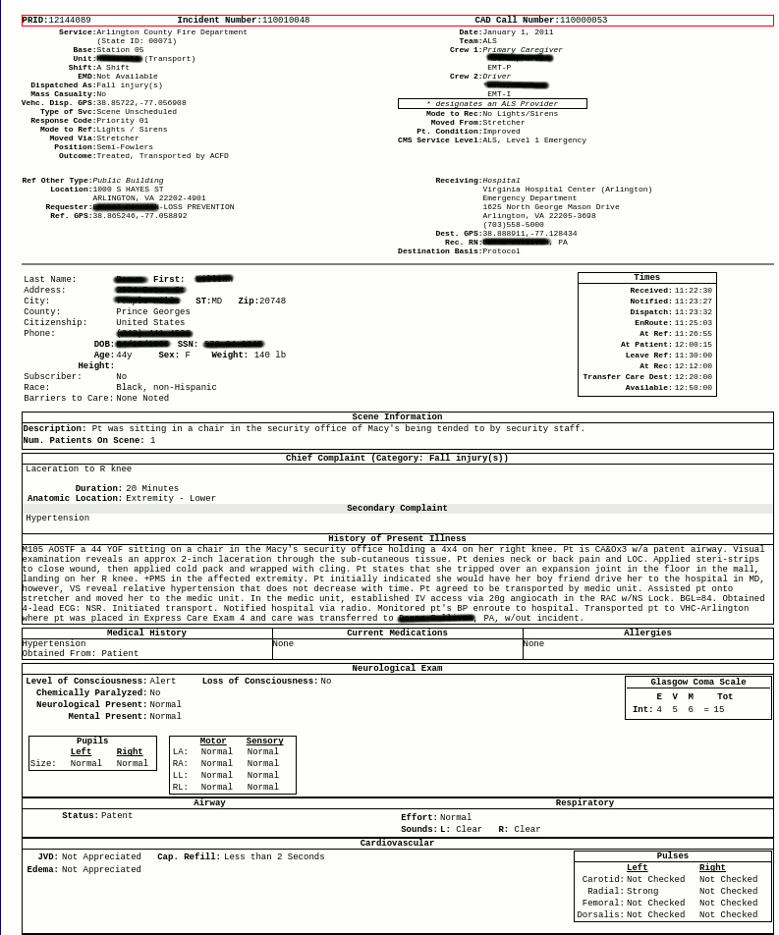

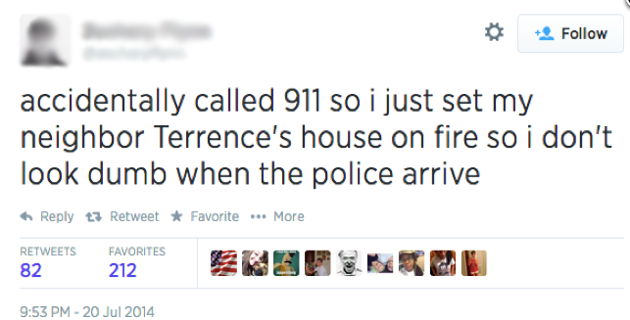

Slide 26
Equity in Alexandria
Lead: Emily Molfino
SDAL Team: Stephanie Shipp, Vicki Lancaster
Sponsor: City of Alexandria, Office of Performance and Accountability

Slide 27
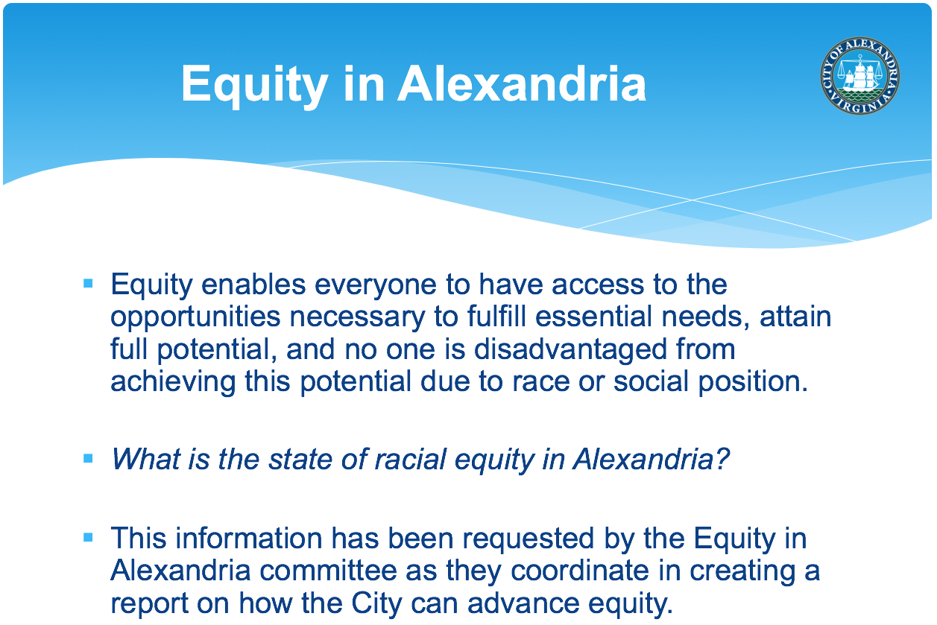

Slide 28
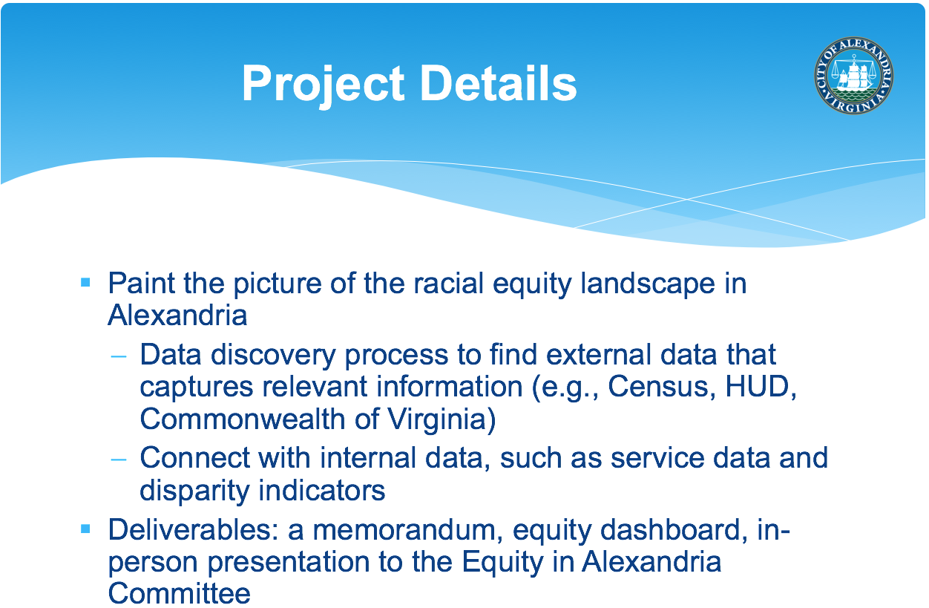

Slide 29
Identifying and Predicting Effects of Trends on Youth Population in Fairfax County
SDAL Lead: Stephanie Shipp
SDAL Team: Vicki Lancaster, Gizem Korkmaz
Sponsor: Fairfax County Division for Countywide Service Integration and Planning Management (CSPIM), Neighborhood and Community Services (NCS), within Health and Human Services (HHS)

Slide 30

Research Questions
Which HHS programs and services may be affected by changes in population size, behaviors, and demographic makeup?
What current and future trends in demographics, housing, and other factors would inform the models to predict changes in their programs?
What are trends in the data that warrant more investigation? e.g., why are kids engaging in less and less physical activity?

Slide 31
Expected Project Outputs
Document work on wiki and in short 2-3 page write-ups summarizing results for each activity.
Literature review on youth behaviors under consideration.
Execution of the SDAL data framework to discover, profile, clean, and transform data sets in preparation for data analysis.
Catalog of available data sources that include: source of the data, a list of variables, observational unit(s), geographic area covered, how often the data are updated, etc.
Project findings and the analyses to support the findings.
Outline of future steps to strengthen insights and capabilities for a broader set of population and economic forecasts for Fairfax County HHS programs and activities.
Poster and presentation summarizing the above outputs

Slide 32
SDAL Data Framework
Notes:
The Data Model consists of the following high-level steps:
Data source discovery and acquisition, primarily identifying and obtaining internal data for use in the modeling.
Data profiling to understand and describe the data.
Data cleaning and restructuring for analysis.
Data linkages to understand the relationships between variables and tables.
Data Exploration including visualization, generation of descriptive statistics, and analysis of patterns and inconsistencies in the data.
The data fitness assessment will evaluate available data sources for issues of completeness, value validity, consistency, uniqueness, duplication, as well as issues of data structure. The results of these analyses will help determine what necessary transformations/cleaning might be needed as well as the fitness of the data for use in further analysis.
The data integration and statistical analysis will produce longitudinal profiles of the county by relevant geographic areas (e.g., high-school boundaries, supervisor areas) and relevant to the research questions. These findings will inform the construction of forecast models.

Slide 33
Local Characterization of Refugee Social Contexts in Place and Time: Insights from local data sources
SDAL Lead: Mark Orr
SDAL Team: Stephanie Shipp, Bianica Pires
Sponsor: Roanoke

Slide 34


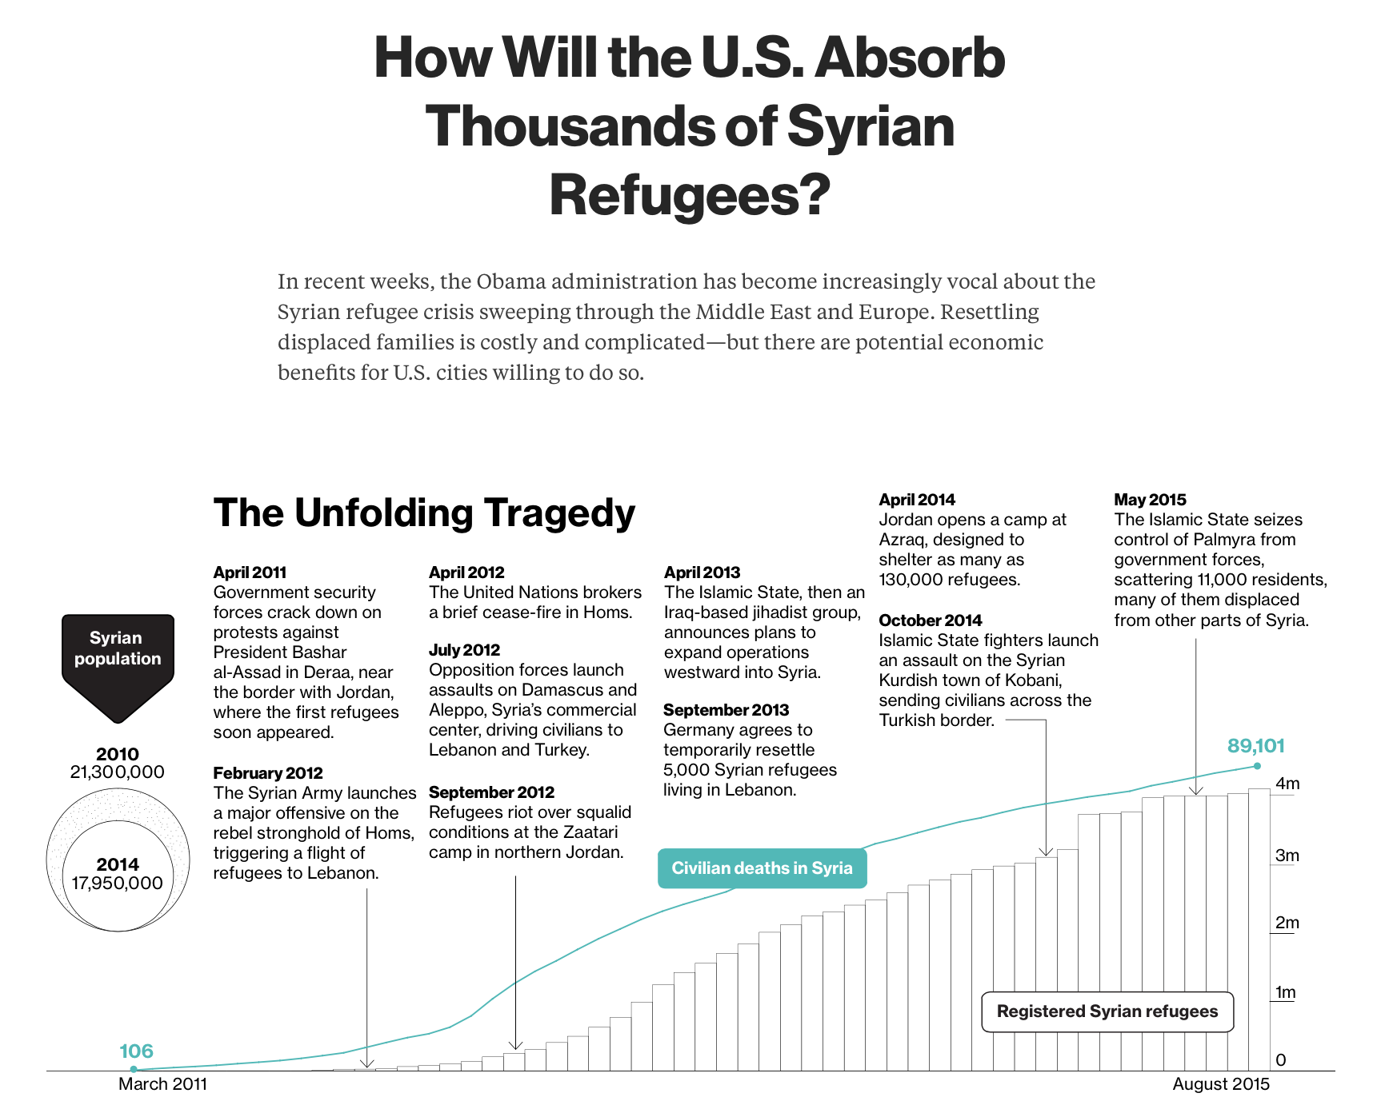
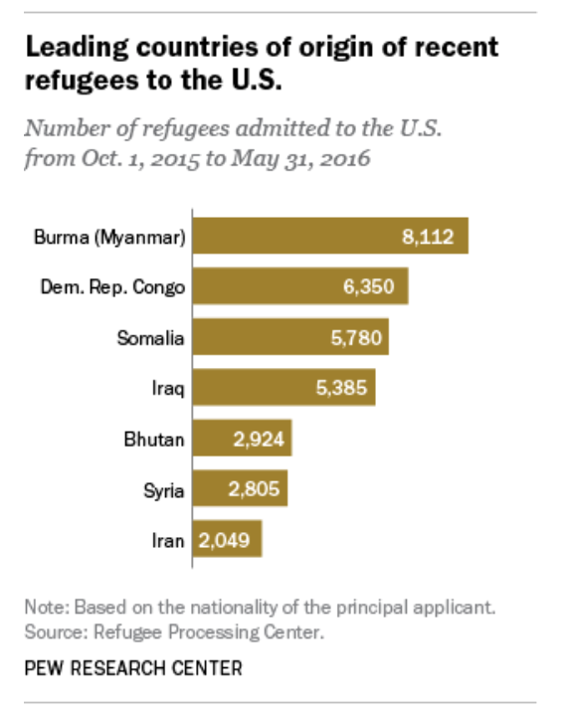

Slide 36
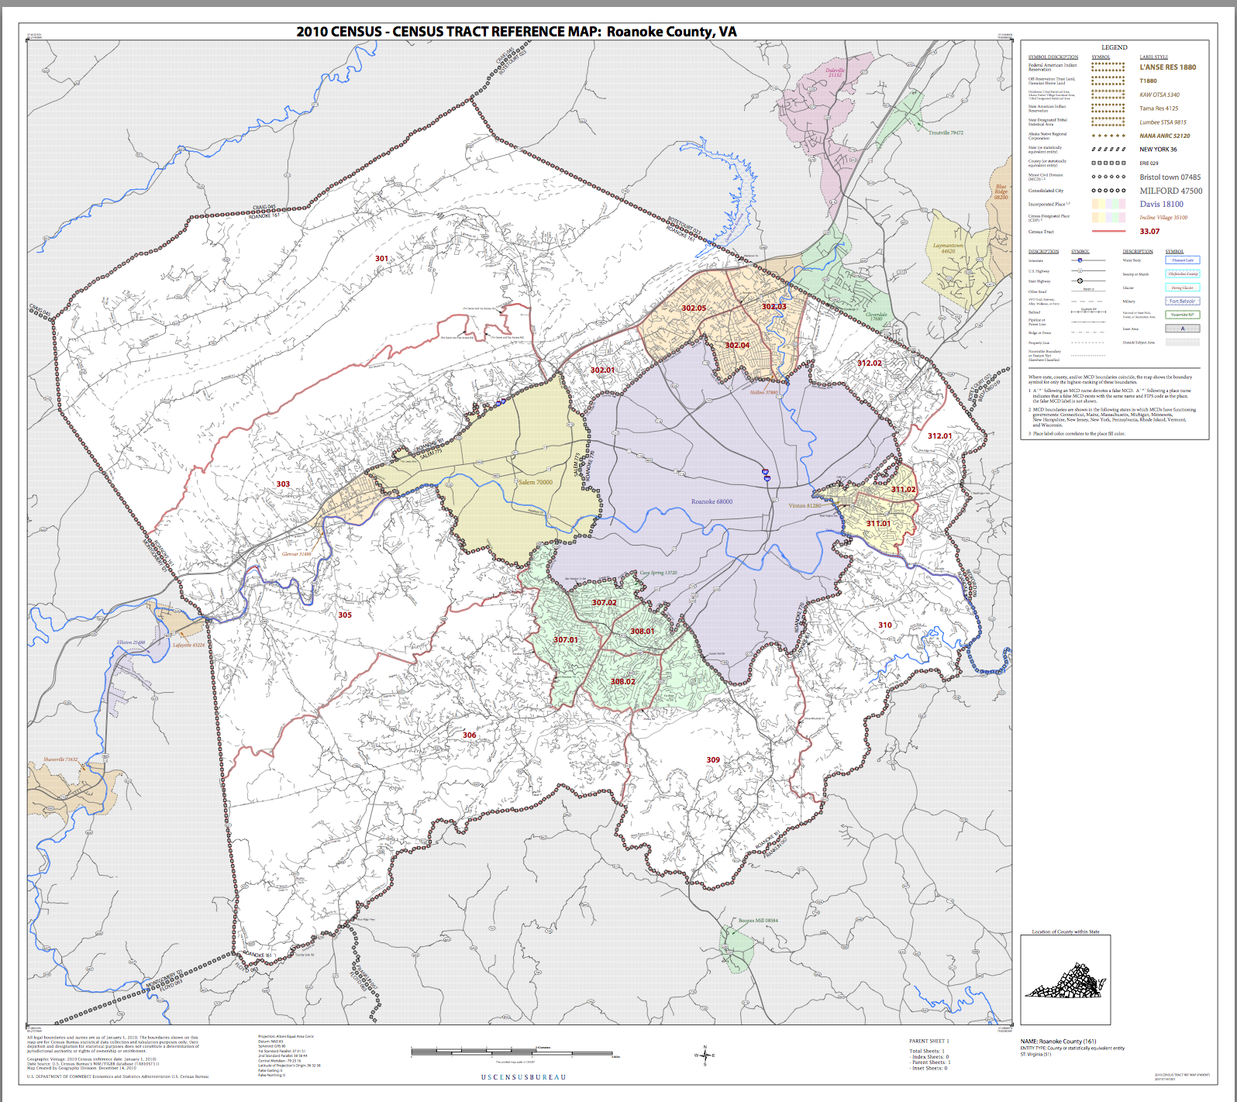
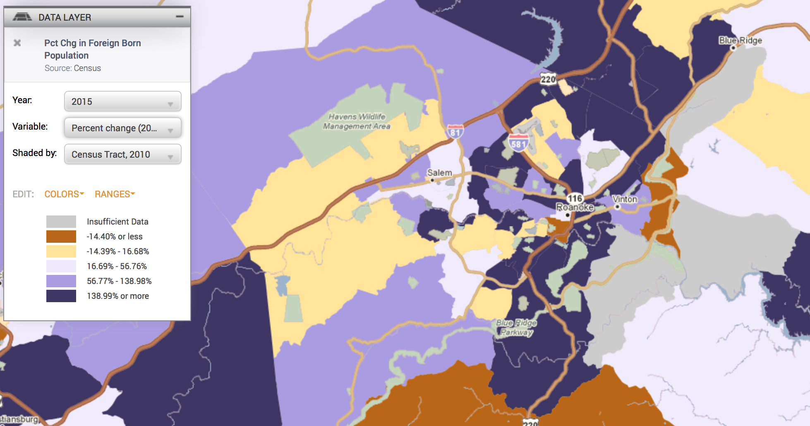
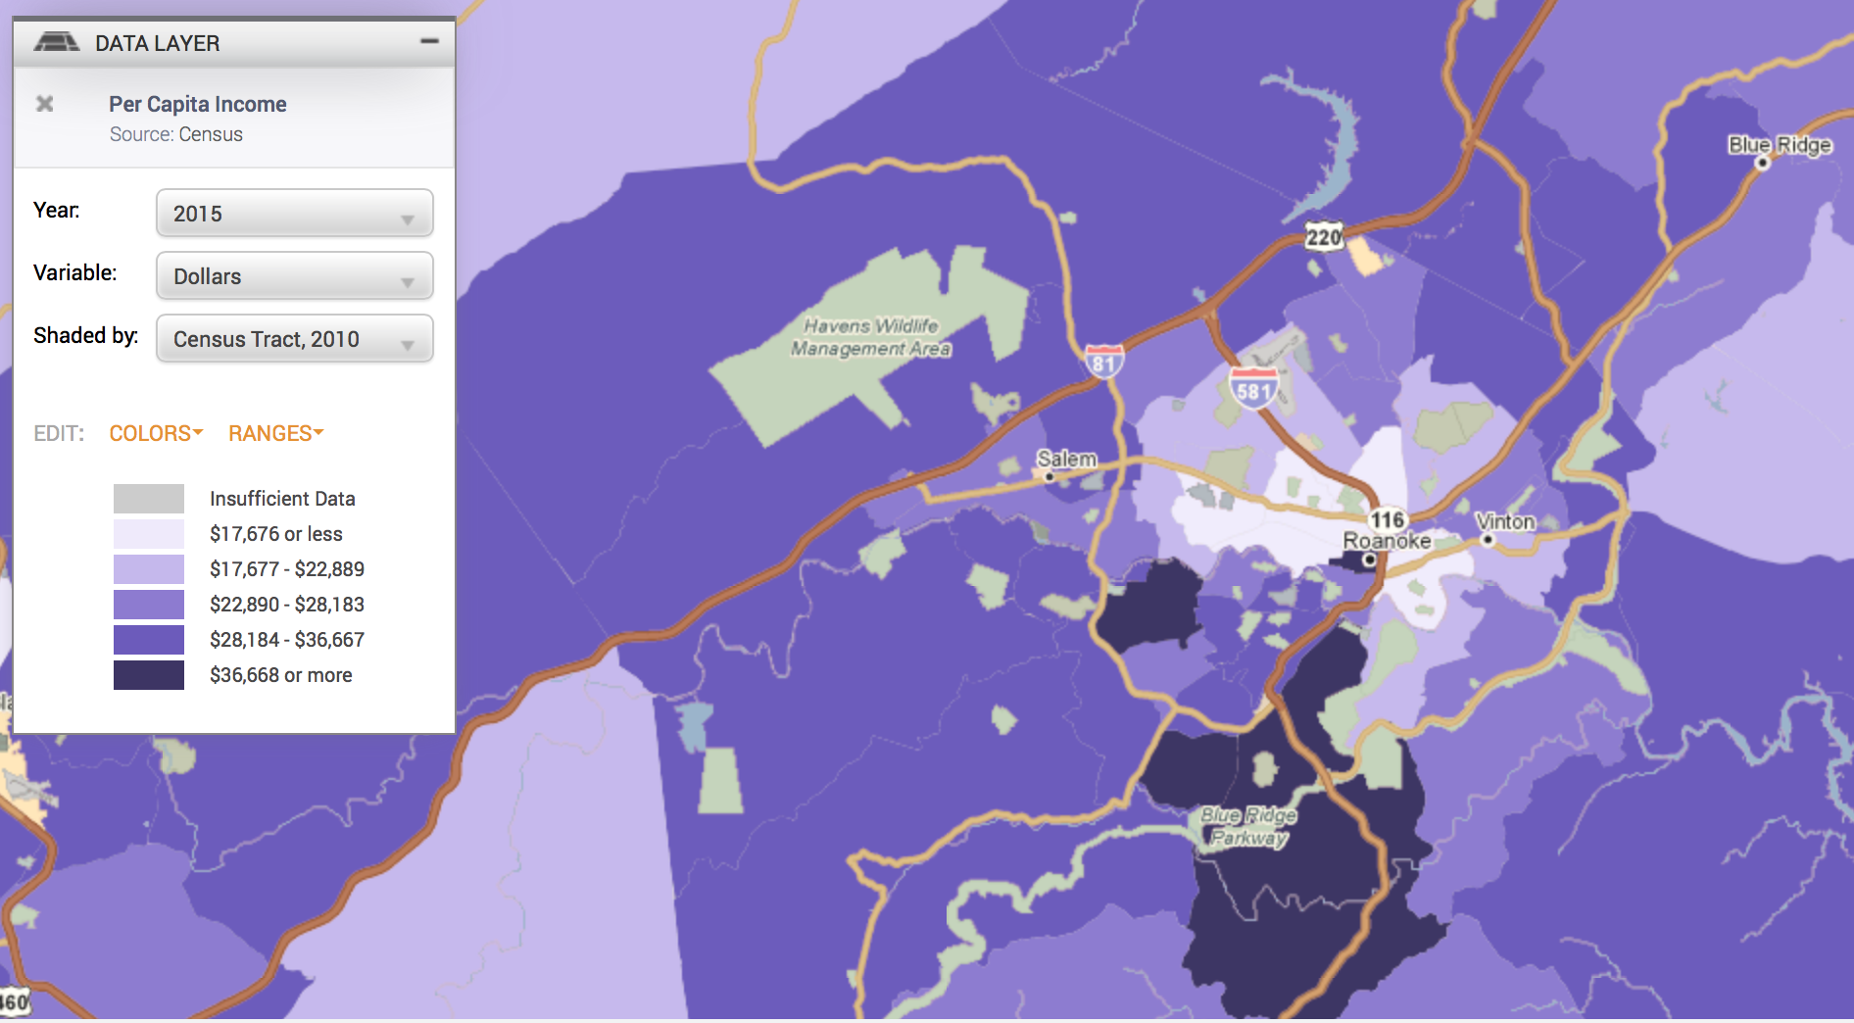
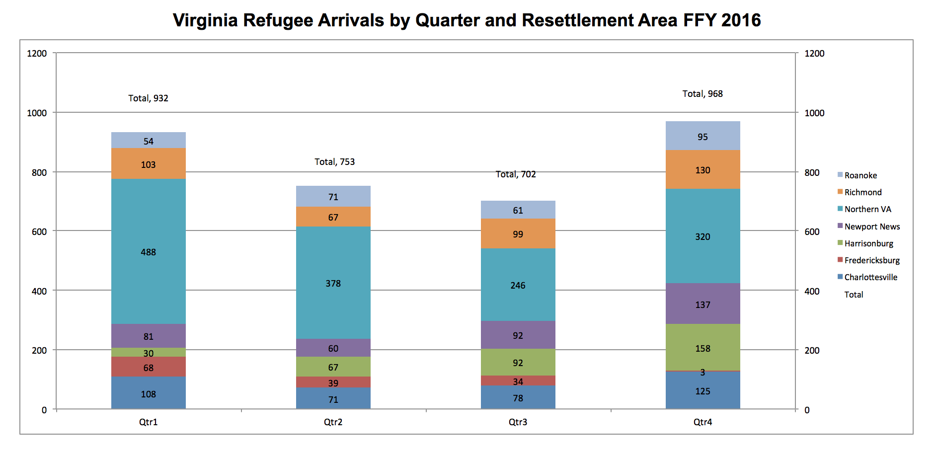

Slide 37
Project Objectives
Issues/Contexts
Across Scales (G → L)
--Substantive
--Methodological/Empirical
--Ethical
--Policy
Data Discovery
--Fed, state, local
--Criminal Justice, economic, education, health, etc.
--All data
Focused
Product
E.G.:
-Provide insight into substantive issue for policy
recommendation
-Solve a technical issue (small n)
-Introduce new and useful data type(s)

Slide 38
Creating Profiles of Army Bases
SDAL Lead: Stephanie Shipp
SDAL Team: Joshua Goldstein, Mark Orr
Sponsor: Army Research Institute (ARI) for Behavioral and Social Science Research

Slide 39
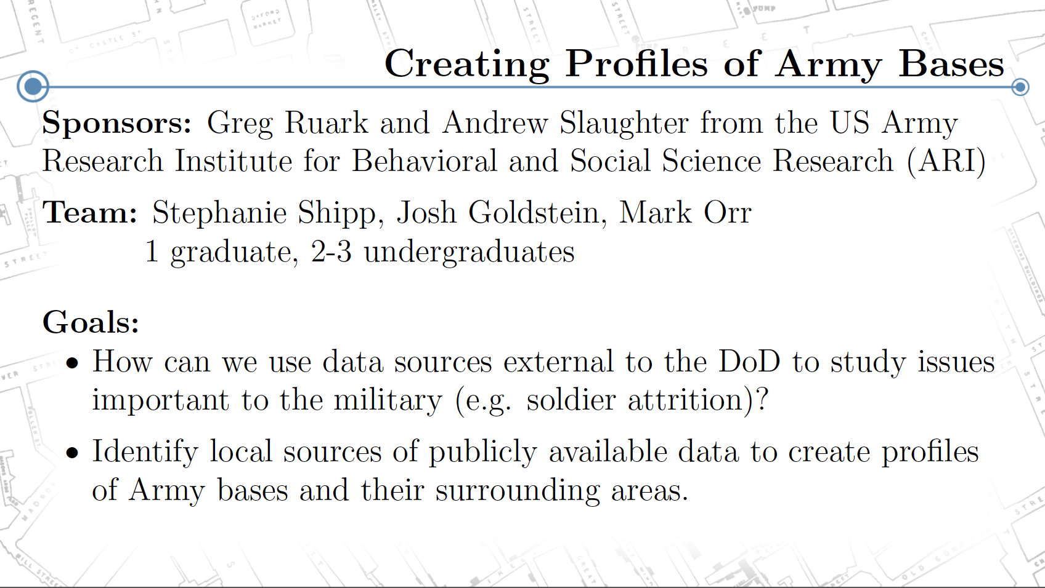
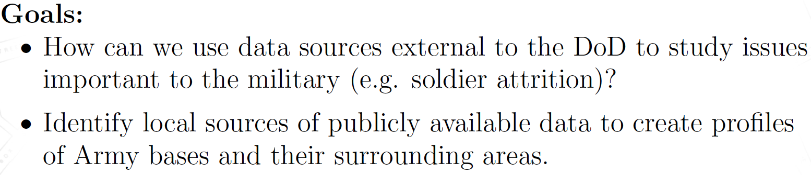

Slide 40
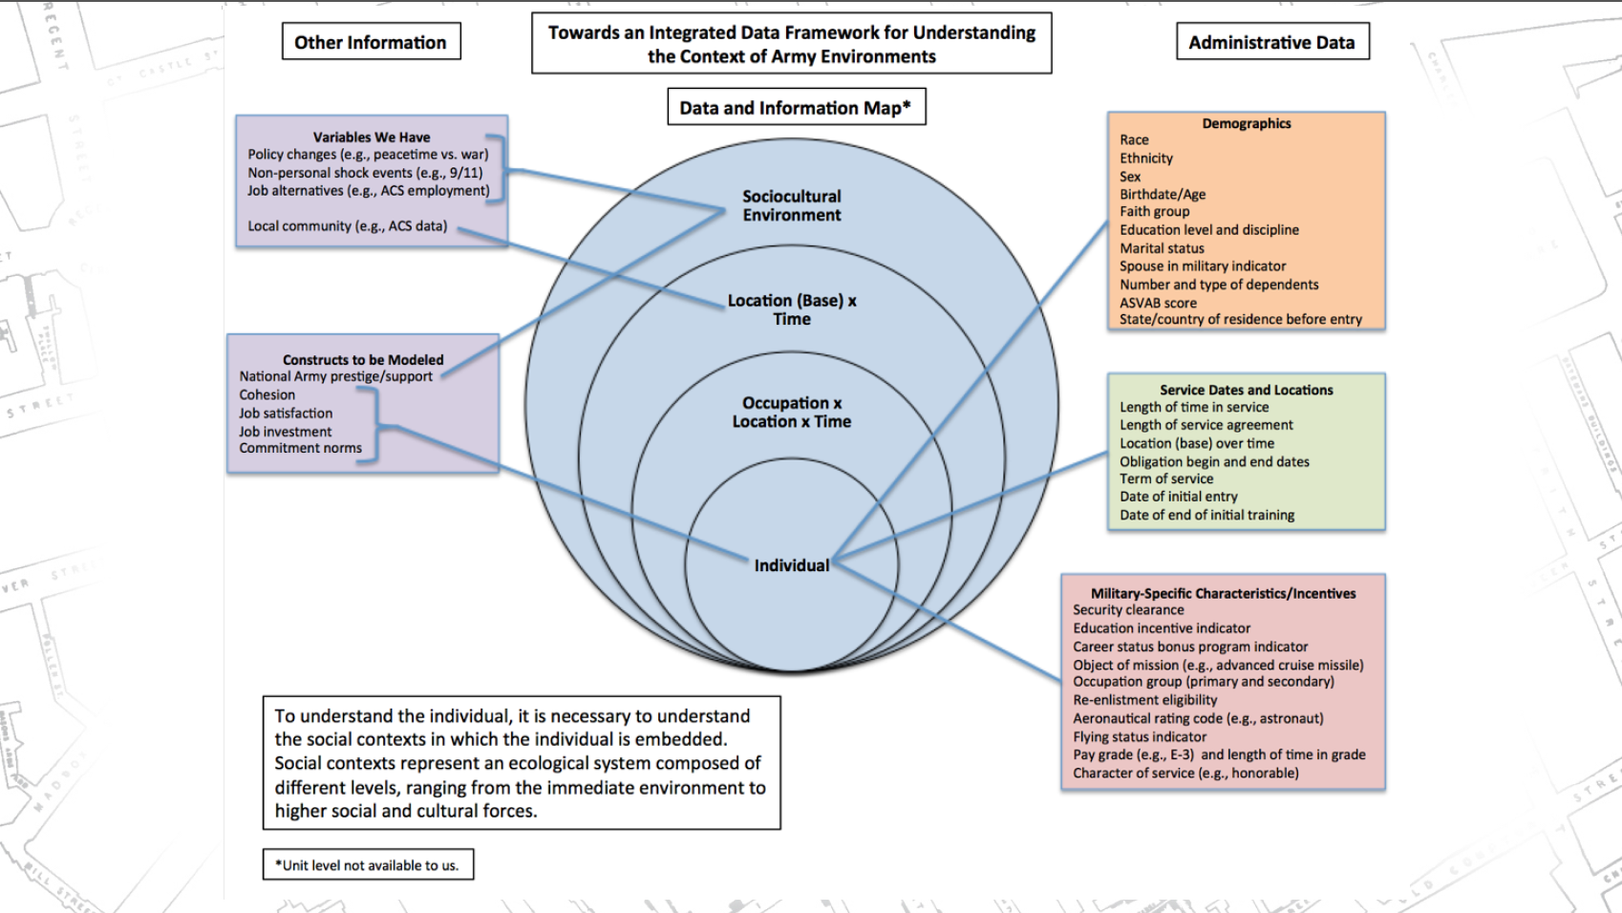

Slide 41
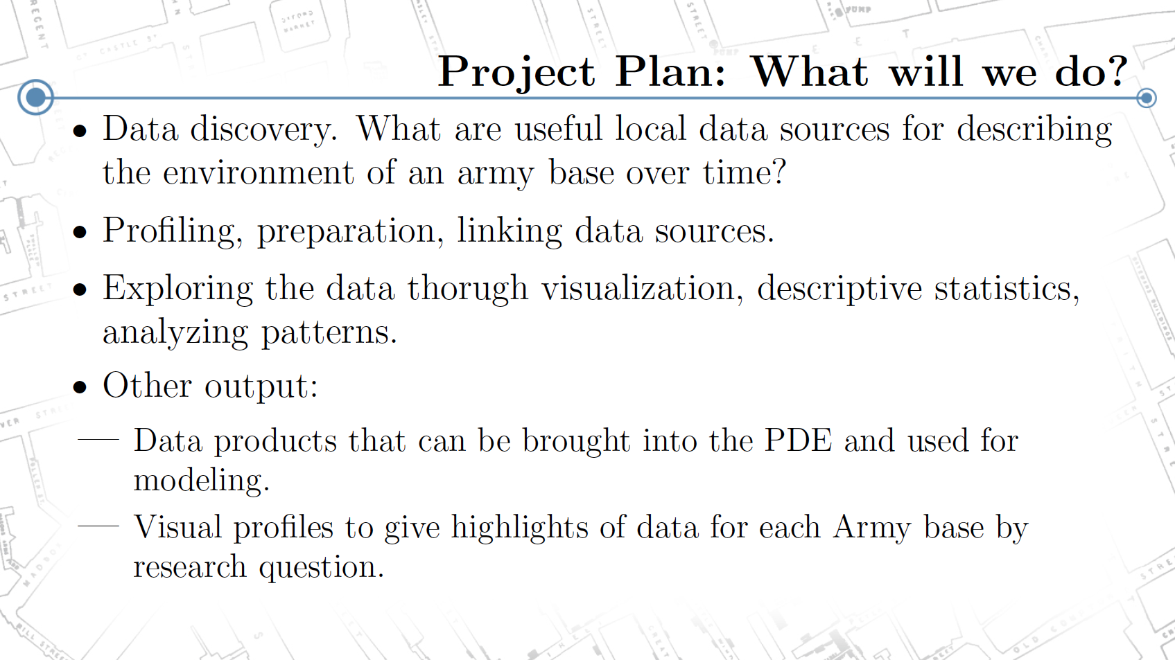

Slide 42
How many people on the beach?
SDAL Lead: Dave Higdon
Sponsor: City of San Diego Lifeguards

Slide 43
How many people on the beach?
They want to estimate how many people use the beach on a given day.
Would like the estimation approach to be easy, but relatively accurate
They have 7 different beaches they need the counts for
One approach, use photos taken from the main lifeguard station to estimate how many people are on the beach at the time the photo was taken.
Would like to use machine learning methods to:
Count number of people in the identified region
Automatically identify an area over which to count people
Given the region and the count, provide an estimate of the total on the beach.
How do we use ML (or other analytics) to count people in the photo?
How many photos are required?
How much training is needed for ML approach to work?
Can we make an app that automatically does this, producing a crowd estimate (with uncertainty bounds)?

Slide 44
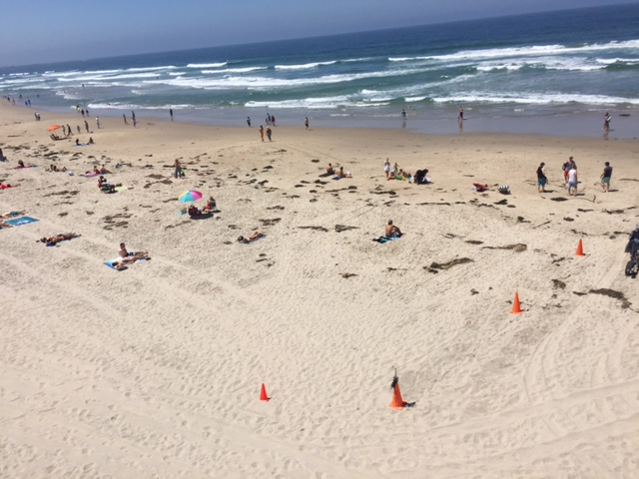
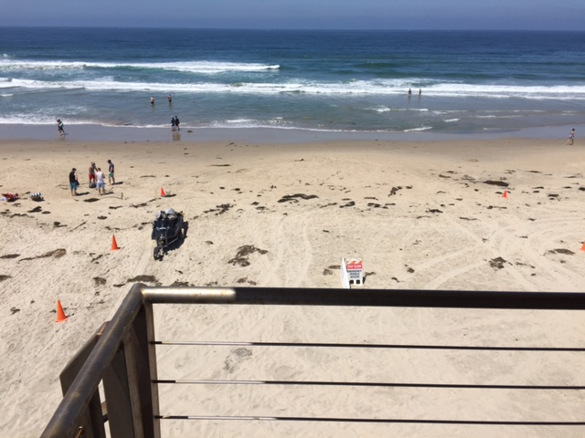
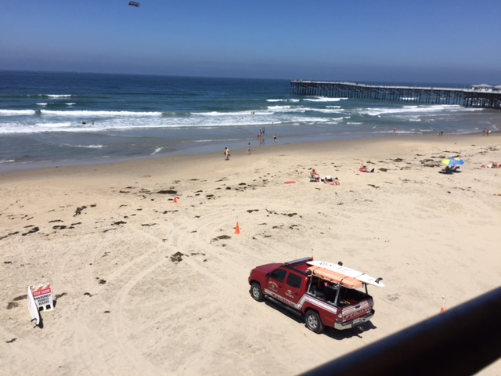
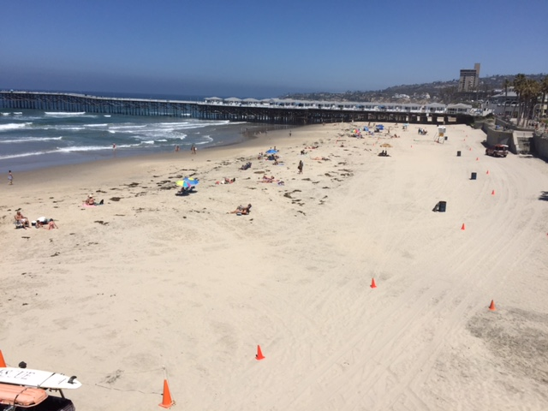
Photos from main PB tower

Slide 45
City of San Diego Contacts
Sargent Rob Brown SDLG
Sargent Brian Clark SDLG
Will have additional times of day to use as a ground truth
Aaron, show the drone movie!

Slide 46
Developing a New, Data-Driven project for New Kent County VA
SDAL Lead: Aaron Schroeder, Dave Higdon
SDAL Team: Vicki Lancaster, Stephanie Shipp
Sponsor: New Kent County Parks and Recreation, Kim Turner

Slide 47
Research Questions
New Kent County has a rapidly changing demographic, leading to challenges how the County shepherds and serves its community.
Two problems elicited from earlier meetings are:
There is a perceived increase in the number of teenagers who have “no place to go” after school. Is this leading to an increase in unwanted behaviors with these teens (e.g. drug use, crimes)?
There is a perception that the number of elderly has grown in recent years, but the transportation, recreation, and other amenities for this population is insufficient. If this is the case, what can, or should, be done to better serve this segment of the population?
We would like to work with officials from New Kent County and Virginia Common Extension to
Find and analyze data sources that can improve our knowledge regarding these issues;
Develop potential courses of action, given what we were able to learn from this data.

Slide 48
Expected Project Outputs
Document work on wiki and in short 2-3 page write-ups summarizing results for each activity.
Explore life in New Kent County to better understand the population, social dynamics, available activities, etc.
Seek out data sources (some basic, some novel) to aid in our understanding of New Kent County.
Brainstorm potential analyses and interventions that could be carried out to aid understanding.
Profile, clean, and transform data sets in preparation for data analysis.
Work with New Kent Officials to understand this data and develop possible intervention strategies.
Plan out how these new interventions could be assessed for efficacy (e.g. RCT?)
Poster and presentation summarizing the above activities.

